Slide 1

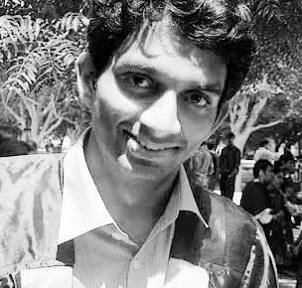
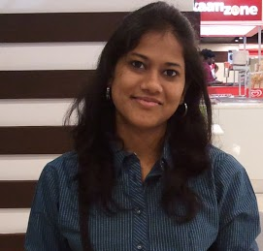

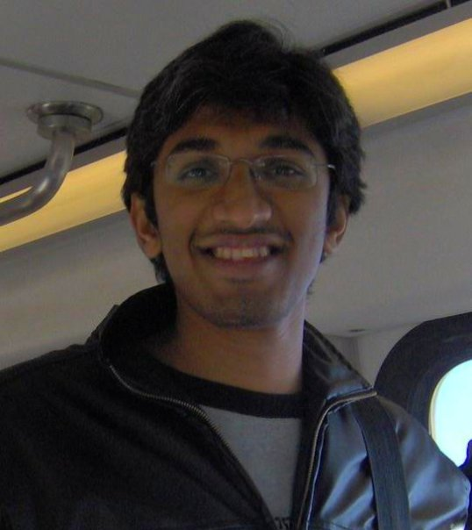

On Controllable Sparse Alternatives to Softmax
Anirban
Laha¹
Saneem A.
Chemmengath¹
Priyanka
Agrawal¹
Mitesh M.
Khapra²
Karthik
Sankaranarayanan¹
Harish G.
Ramaswamy²
¹IBM Research AI ²IIT Madras
NeurIPS 2018 paper: bit.ly/paper-neurips2018
Email: anirbanlaha@gmail.com
Notes:
Thanks *AnDrew* for the nice introduction. Hello Everyone! I am Anirban. I am going to present our work on “On Controllable Sparse Alternatives to Softmax” which appeared in NeurIPS. This is a joint work with my collaborators from IBM Research and IIT Madras.

Slide 2
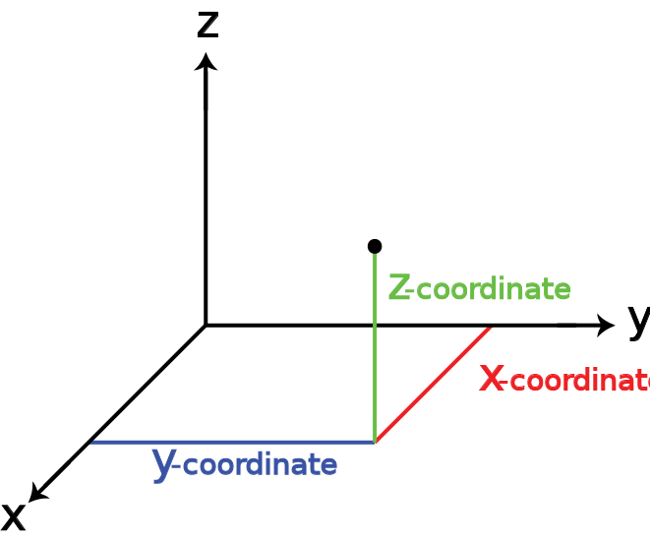
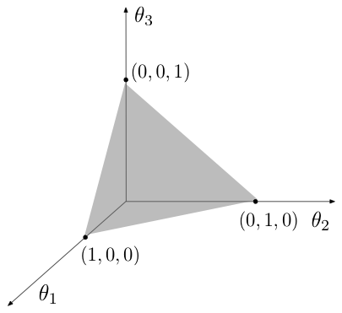
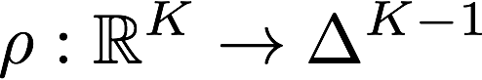
Probability mapping functions
A function ρ which takes a real score vector z and produces a probability distribution p.
Real Vector z
Probability
Distribution p
Notes:
To start with lets define the problem we are looking at.
Given a real score vector z, how can we obtain a probability distribution p.
As we can see, the properties of a probability distribution should hold for the the elements of p.
This talk will discuss about all kinds of function rho which can transform such a vector z to a distribution p.
Essentially, this step can be visualized as taking any point in the real space z and finding its equivalent point p in the probability simplex.

Slide 3
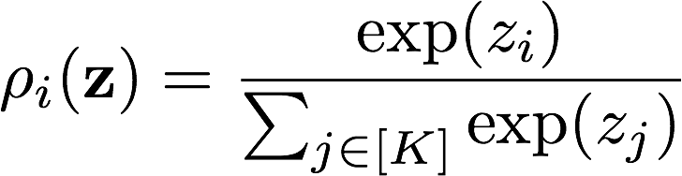
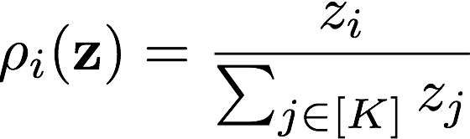
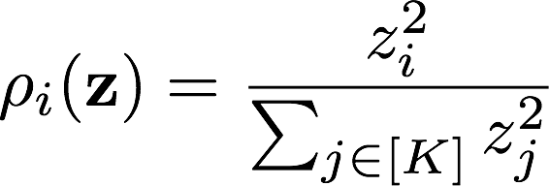
Known probability mapping functions
Softmax:
Sum-normalization:
Spherical softmax:
Notes:
There are many ways to do so. Our very familiar softmax function is one way to do such a transformation as it produces probabilities.
Similarly, other not so well-known techniques like sum-normalization and spherical softmax can also produces probabilities.

Slide 4
Applications
Probabilistic classification – Multiclass classification, Multilabel Classification.
Neural Attention Models – Attention networks need a probability distribution over input states while generating output states.
Memory Networks, Reinforcement Learning, Knowledge distillation and many more.
Notes:
Now why do we care to study such functions?
The answer is there are various places where we use softmax function. be it classification or for attention models or memory networks, the list is endless.
Softmax is ubiquitious in all of these areas because of its various nice properties.

Slide 5
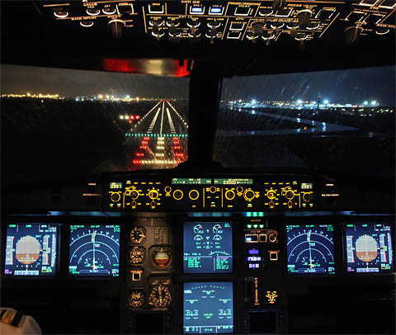
Neural attention models
Focus only on the important information.
Model learns what to attend to based on the input and and its current state.
Weighted combination of parts of inputs used to predict current output.
Weights are probabilities. → SOFTMAX
Notes:
For example, lets take a look at the image of cockpit. Here there a plethora of controls and instruments. However, not all of them are important for a particular situation.
A pilot only needs to focus (attend) on the sensors which matter for a situation. Say, landing or take off.
Similarly, attention models learn to attend to only on important parts of the input. This attention is usually computed using a softmax function in case of soft attention.
Attention weights which are probabilities produced by softmax are finally used to provide a weighted combination of inputs to the neural model.
We will be looking how these probability distribution is computed while doing weighted averaging.

Slide 6
Limitations of Known probability mapping functions
Softmax:
Sum-normalization:
Spherical softmax:
Cannot be sparse
Not full-domain
Not monotonic
Notes:
Now there are known limitations of the existing probability mapping functions. For example, the way softmax is defined, as the numerator can never be zero, it is impossible for softmax to always produce non-zeros values in its output distribution. Even though values can be very close to zero, but they will never be exactly zero. That’s why softmax outputs can never be sparse.
On the other hand, sum-normalization is typically not used as it cannot work with negative values, which violates the criteria for probabilities.
Similarly, spherical softmax has an issue of non-monotonicity due to the presence of the square term.
Thus we begin the search for probability mapping functions which do not have these shortcomings.

Slide 7
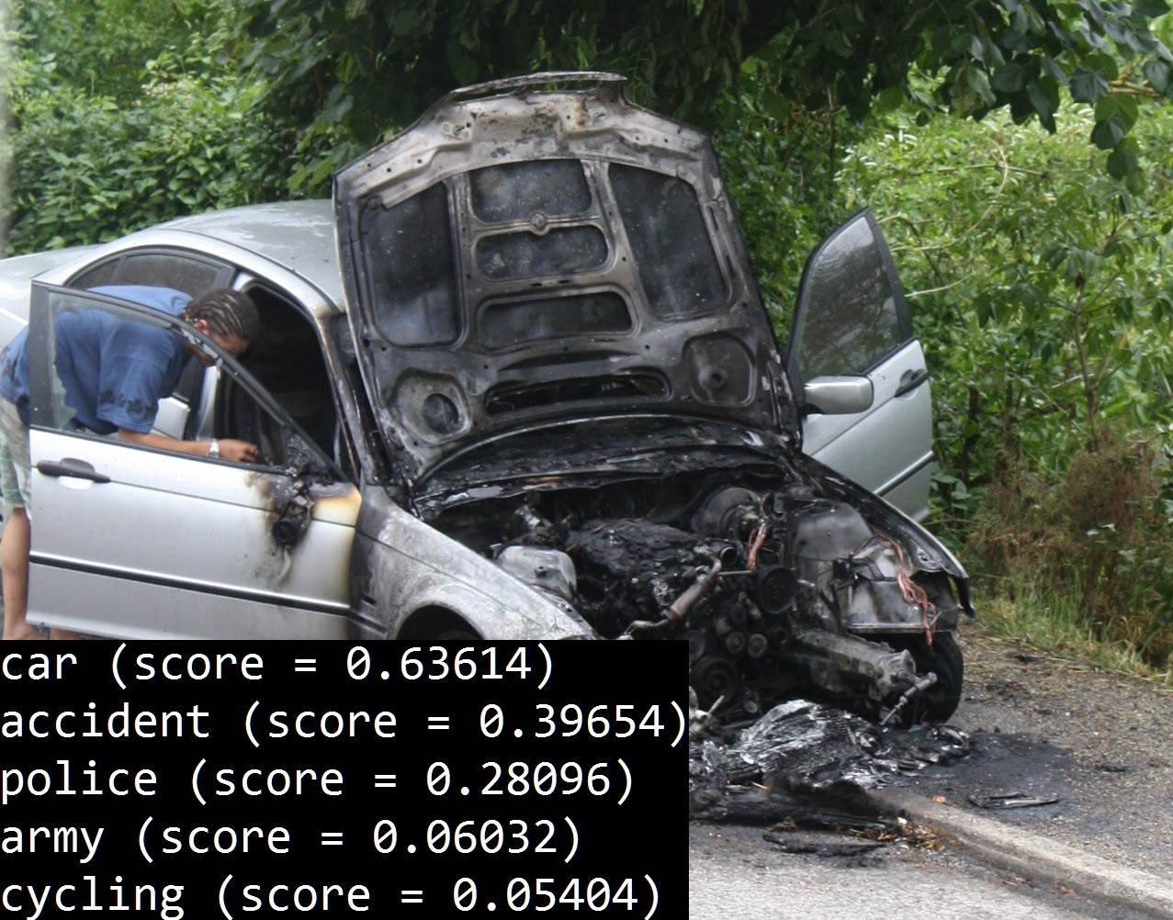
Need for sparsity
In multilabel classification, only a few labels out of 1000s of possible labels are TRUE.
Very few labels is TRUE
Notes:
Now why do we need sparsity? Lets consider a multilable classification problem. In this problem, for a single image, there can be multiple labels which are true. However, the number of true labels are much less than the possible labels which could be 1000s.
Hence, it is much needed to have a probability mapping function where only a few labels are turned on and others are zero.

Slide 8
Need for sparsity
In attention models/memory networks, sparser probabilities make computation faster.
Less non-zero weights means lesser operations (during weighted combination)
Most of the words not needed
Textual entailment
Notes:
In a different setting like attention model (specifically for the problem of textual entailment)

Slide 9
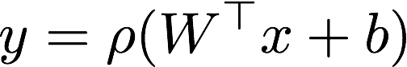
Where do we need sparsity?
Sparsity in output vs Sparsity in parameters.
Usual regularizer techniques?.
L1 norm is ALWAYS 1 for all probability distributions (which is output).
Sparsity in output
Sparsity in parameter

Slide 10
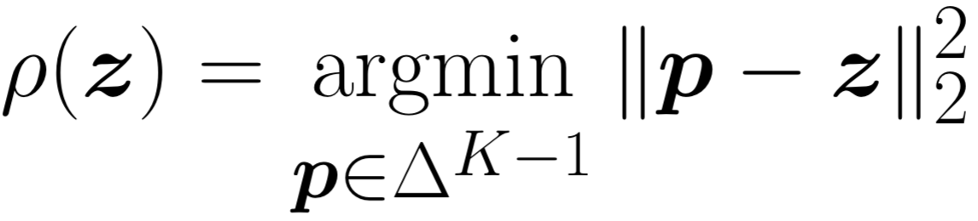
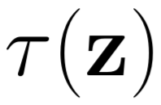
Sparse Probability Maps
Sparsemax : Projects the score vector onto probability simplex
Computing sparsemax: Sort the scores and find a threshold.
Z₍₅₎
Z₍₄₎
Z₍₃₎
Z₍₂₎
Z₍₁₎
[Martins, Andre, and Ramon Astudillo. From softmax to sparsemax: A sparse model of attention and multi-label classification. ICML 2016]
Notes:
Sparsemax: Martins, Andre, and Ramon Astudillo. "From softmax to sparsemax: A sparse model of attention and multi-label classification." International Conference on Machine Learning. 2016.
Move threshold value tau(z) till the term becomes a valid probability map.
Translation invariant: Adding a constant to each element in z is not going to change output of sparsemax. This is a very important property which we have used in many of our proofs.

Slide 11
Visualization
Sparsemax:
Sparse Region
Sparse Region

Slide 12
Known probability mapping functions
No control over sparsity!!

Slide 13
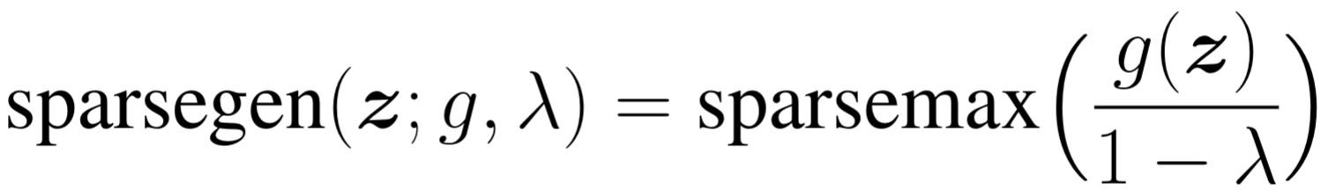
Sparsegen – A Unified Framework
A family of sparse probability mapping functions:
Equivalence:
Closed Form solution exists.

Slide 14
Controls for Sparsity
Two kinds of controls:
Proposed formulations:
sparsegen-lin : Allows only changing 𝝀
sparsehourglass : Allows changing g(z)
These are just two out of many variants possible!!!
Control using different g(z)
Control by changing
𝝀

Slide 15
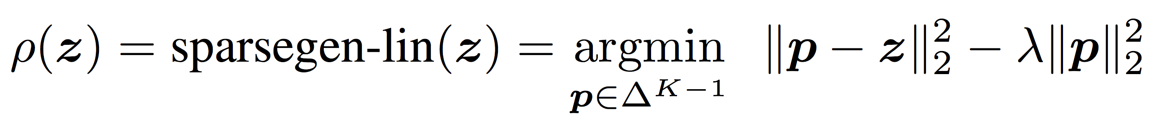
Sparsity Control 1 : sparsegen-lin
Control over width of non-sparse region:

Slide 16
Sparsity Control 2 : sparse-hourglass
Control over shape of non-sparse region:

Slide 17
Desirable properties of probability mapping functions
Translation invariance:
Adding a constant to every element of z should not change output distribution.
Sparsemax, softmax and sparsegen-lin
Scale invariance:
Multiplying a constant to every element of z should not change output distribution.
Sum-norm and spherical softmax.
Sparsemax
Sum-normalization

Slide 18
sparse-hourglass: Bridge between Translation Invariance and Scale Invariance
Parameter q helps trade-off between translation and scale invariances.
Translation Invariance: Adding a constant value to all dimensions of z keeps p unchanged.
Scale Invariance: Multiplying all dimensions of z by a constant value keeps p unchanged.
Translation Invariance!!!
Scale Invariance!!!

Slide 19
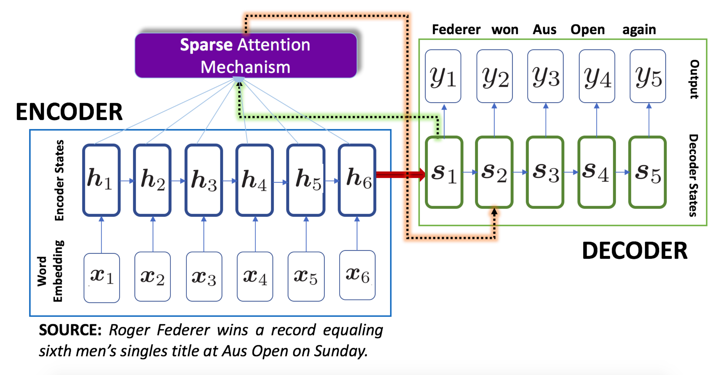
Experiments (Controlled Sparse Attention)
Seq2seq Models with attention:
Neural Machine Translation (EN-FR, FR-EN).
Abstractive Summarization (Gigaword, DUC2003, DUC2004).
OpenNMT framework (PyTorch).
Replace ‘softmax’ with sparsemax, sparsegen-lin and sparsehourglass.
Also varied temperature in softmax as another baseline.

Slide 20
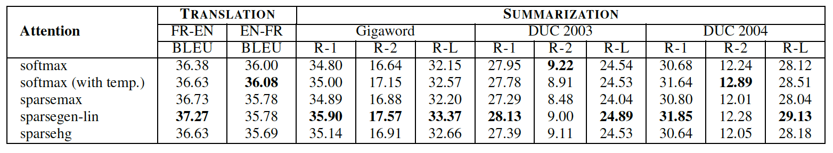
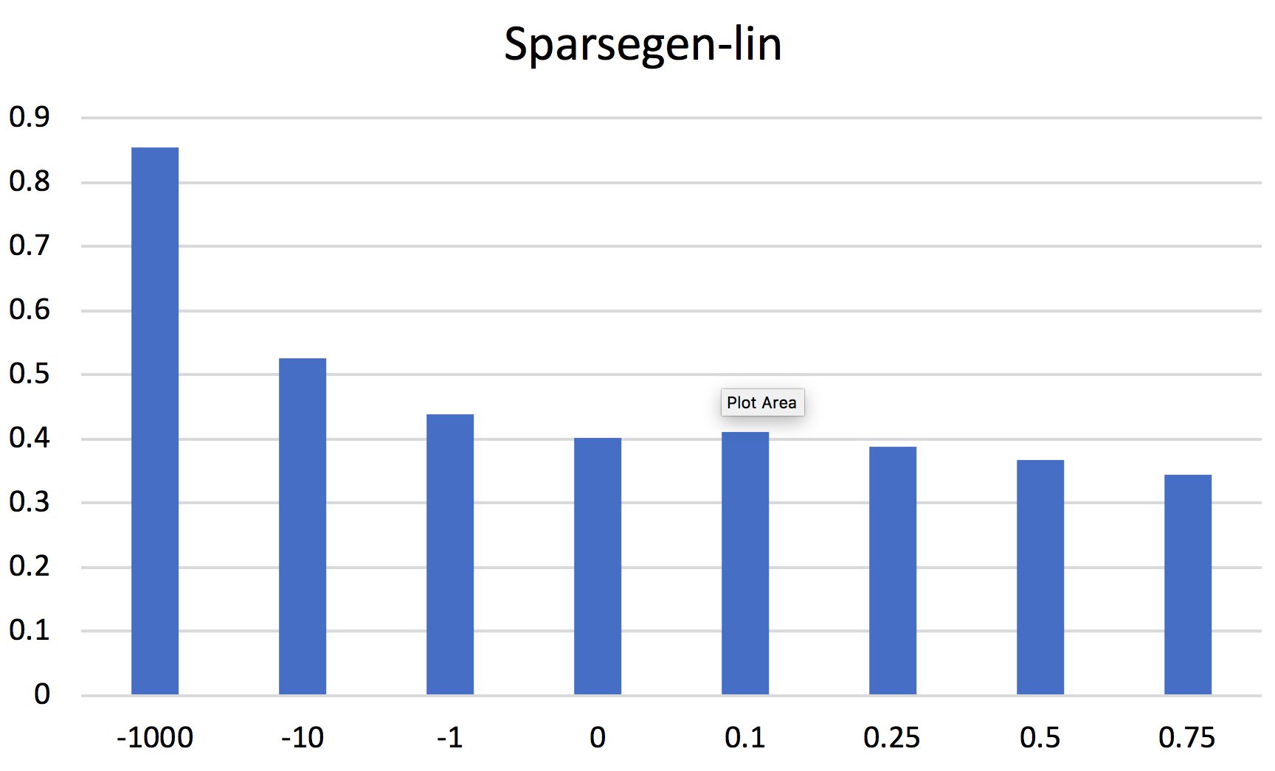
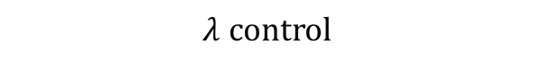
Results (Controlled Sparse Attention)
Non-zeroes
Higher 𝝀 → Sparser attention
$$λ control$$

Slide 21
Multilabel Classification

Slide 22
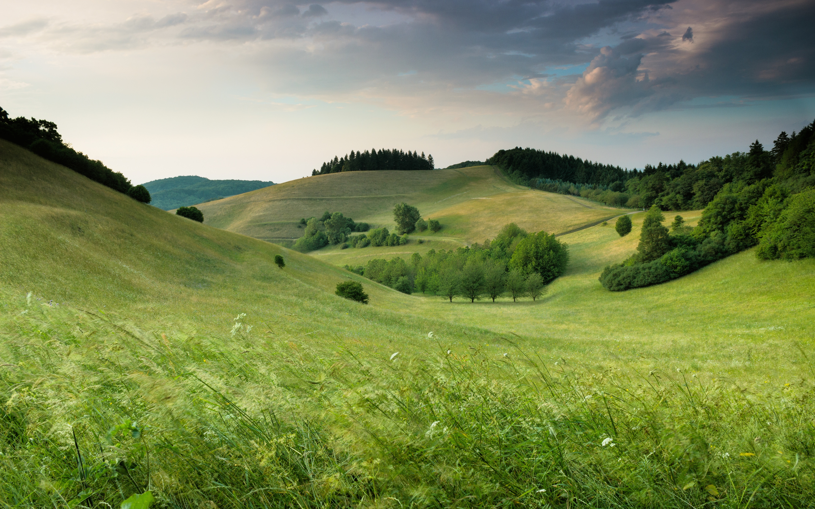
Multilabel Classification
More than one labels for an instance can be true.
Usual approach : Separate logistic sigmoid based binary classifier for every label followed by thresholding.
Trees
Plains
Sky
Hills
Grass
Greenery
Clouds
Landscape
Tree Classifier
0/1
Greenery Classifier
0/1
Grass Classifier
0/1

Slide 23
Multilabel Approach
Another approach: Apply sparse probability mapping function. Non-zeroes are predicted labels, zeroes are non-labels.
Dog : 0
Greenery : 0.5
Grass : 0.2
Elephant : 0
Clouds : 0.1
Sunset : 0
Hills : 0.2
Score for Dog
Score for Greenery
Score for Grass
Probability mapping function
Score for Elephant
Score for Clouds
Score for Sunset
Score for Hills
Single Classifier

Slide 24
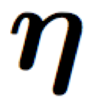
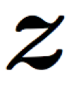
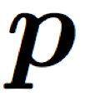
Training this Approach
If sparse output layer is there in a model then with any loss function the model objective function won’t be convex.
label
Model
probability
mapping function
Loss function
input

Slide 25
Don’t use probability map in training
Training:
Inference
label
Loss function captures
The essence of mapping function
Model
Loss function
input
Model
probability
mapping function
predictedlabel
input
Notes:
The only solution is to remove the sparse mapping function from training phase. Convexity only matter in the training phase. We use probability mapping function only in the prediction phase.
But training phase should have some property of this mapping function. We propose a new loss function which capture the “Essence” of mapping function.

Slide 26
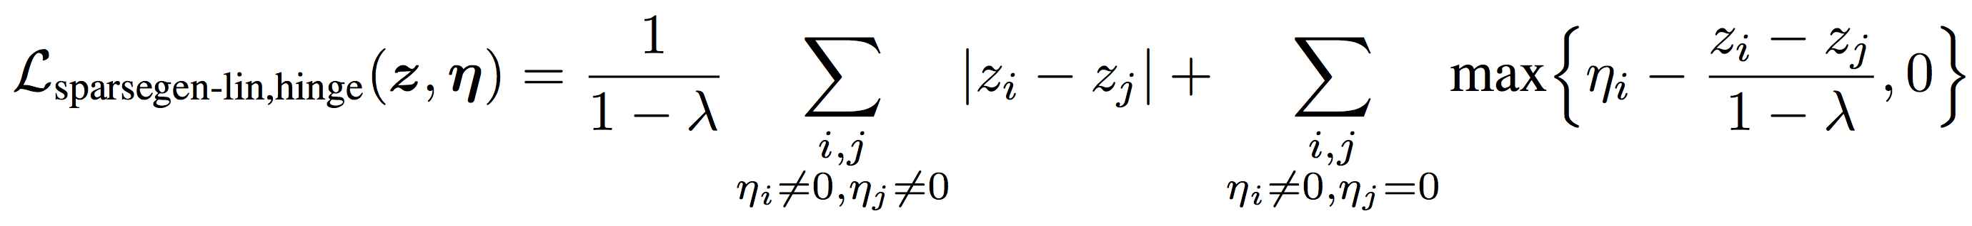
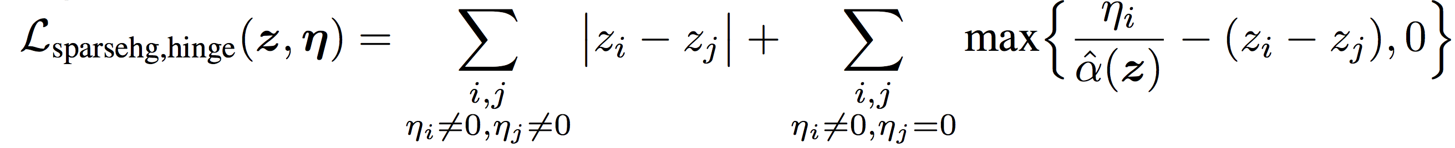
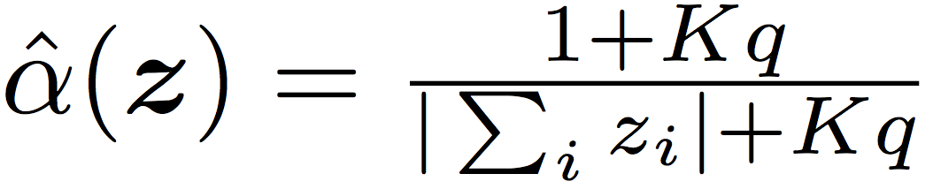
CONVEX hinge-based loss functions
Loss for sparsegen-lin :
Loss for sparse-hourglass :

Slide 27
Experiments (Multilabel Classification)
Synthetic Multilabel Experimental Setup:
Varying mean #labels.
Varying range #labels.
Varying document length.
Competing models:
Baseline softmax+log.
Baseline sparsemax+huber [ICML 2016].
Proposed sparsemax+hinge.
Proposed sparsehg+hinge.

Slide 28
Results (Multilabel Classification)
Non-zeroes

Slide 29
Key Contributions/Takeaways
A unified framework for sparse probability mapping functions.
Formulations sparsegen-lin and sparse-hourglass – control over sparsity.
Convex hinge-based loss functions for multilabel classification.
Sparser and more accurate prediction for multilabel classification.
Sparsity control over attention heatmaps in neural machine translation and abstractive summarization.

Slide 30
References
[1] André F. T. Martins and Ramón F. Astudillo. (2016) From softmax to sparsemax: A sparse model of attention and multi-label classification. [ICML 2016]
[2] Alexandre de Brébisson and Pascal Vincent. (2016) An exploration of softmax alternatives belonging to the spherical loss family. [ICLR 2016]
[3] Vlad Niculae and Mathieu Blondel. (2017) A regularized framework for sparse and structured neural attention. [NIPS 2017]

Slide 31
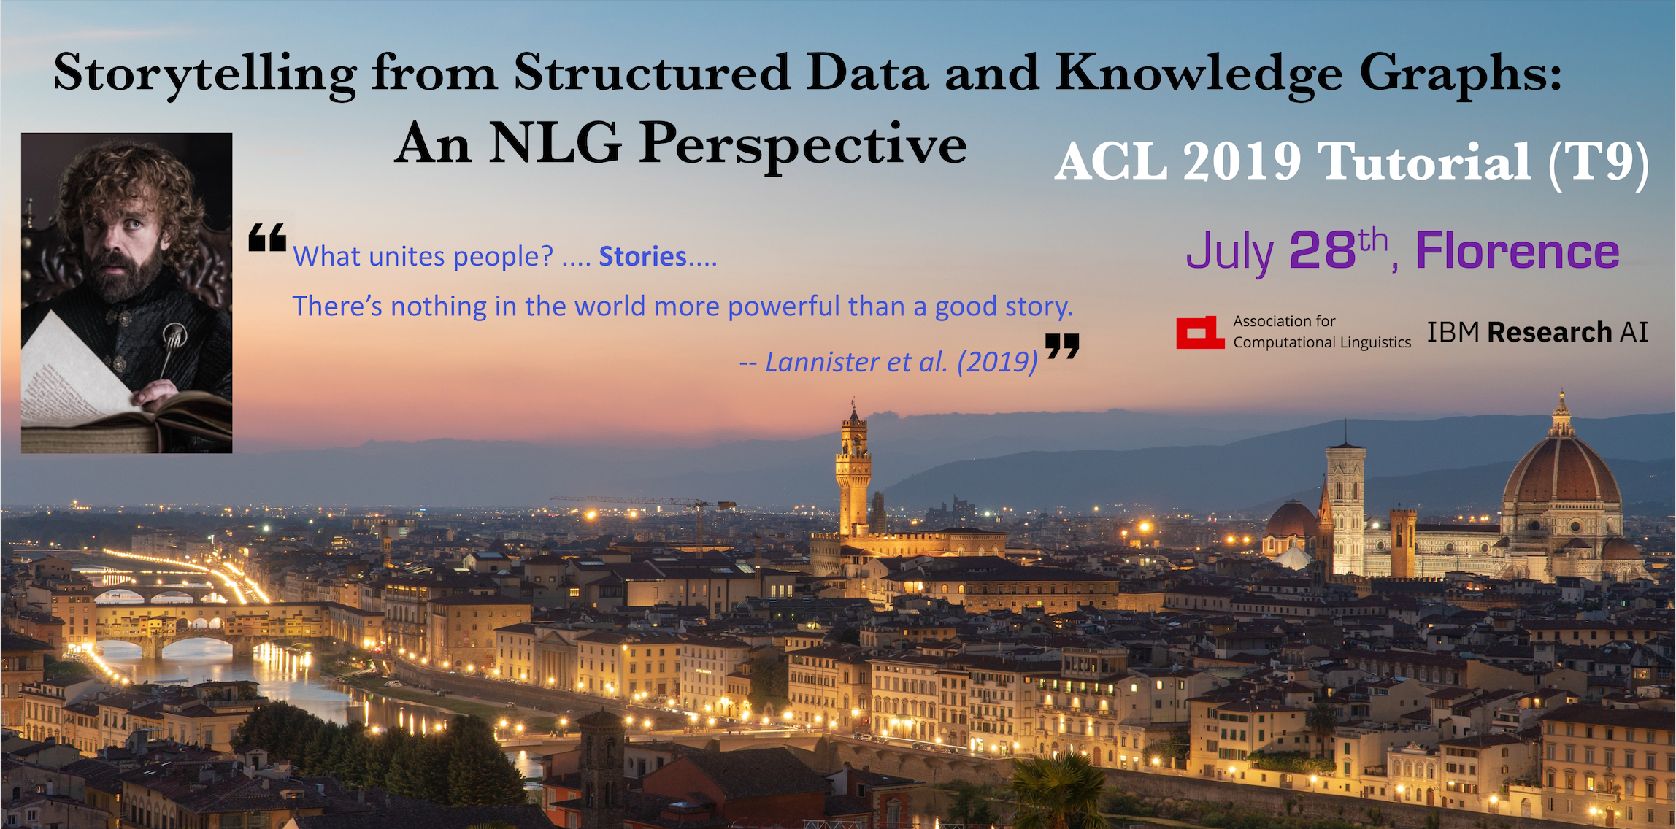
NLG Tutorial at ACL 2019
ACL Tutorial homepage: bit.ly/nlg-acl19

Slide 32

Questions

Slide 33
Backup Slides

Slide 34
Visualizing probability mapping function
Contour plots of 2D probability maps:
Softmax
Sum-normalization
Spherical softmax
Sparsemax
Notes:
Visualizing probability mapping functions:
Input is [z1, z2] and output is [p1, p2]. These are contour plots of p1 given [z1, z2]. This plot contains everything about the mapping function as p2 = 1 - p1.
Looks like softmax is also translation invariant.
Sparsemax has big regions where [p1, p2] = [0, 1] and [1, 0]. Which means any value of z which falls in those place results in sparse distribution.
No other functions has sparse regions of z.
We are on a search to find functions which gives a control on sparsity. Some hyper parameter to which can be tuned using a validation dataset.

Slide 35
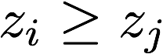
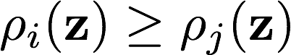
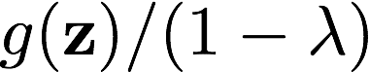
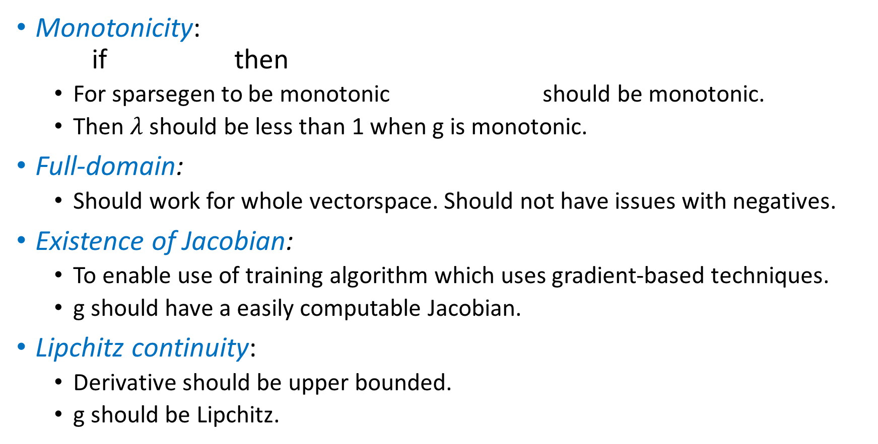
Desirable properties of probability mapping functions
Monotonicity: if then
For sparsegen to be monotonic should be monotonic.
Then $λ$ should be less than 1 when g is monotonic.
Full-domain:
Should work for whole vectorspace. Should not have issues with negatives.
Existence of Jacobian:
To enable use of training algorithm which uses gradient-based techniques.
g should have a easily computable Jacobian.
Lipchitz continuity:
Derivative should be upper bounded.
g should be Lipchitz.

Slide 36
Scale or translation invariance
Why?
Intuitively we want [100, 101] to map to something closer to [0.5, 0.5]
Existing scale invariance functions can’t be used in practise (sum-norm, spherical softmax)
Scale invariant functions are not Lipchitz continuous and is undefined at z=0.
Trade-off between translation and scale invariance?
[0, 1]
sparsemax
[0, 1]
[100, 101]
sparsemax
[0, 1]

Slide 37
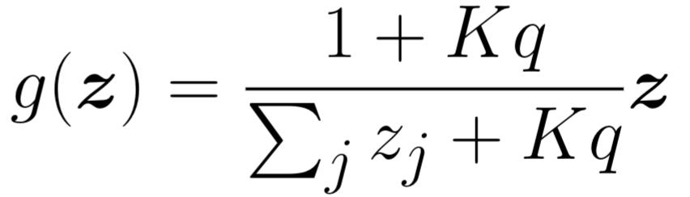
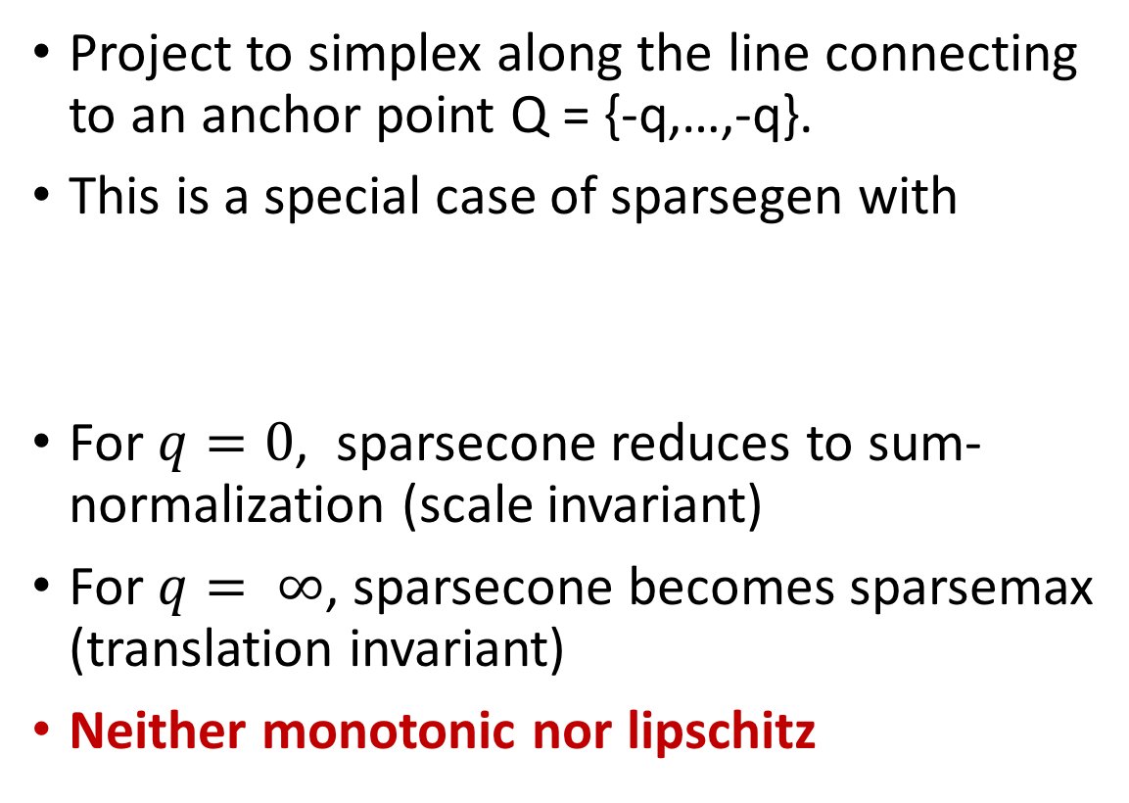
Approximate scale invariance
Project to simplex along the line connecting to an anchor point Q = {-q,…,-q}.
This is a special case of sparsegen with
For $q=0$, sparsecone reduces to sum-normalization (scale invariant)
For $q= ∞$, sparsecone becomes sparsemax (translation invariant)
Neither monotonic nor lipschitz
Notes:
Sparsecone is not monotonic for those z when denominator in g(z) equation becomes negative. That is if $\sum_j z_j + Kq < 0$. It is also undefined when $\sum_j z_j + Kq = 0$.

Slide 38
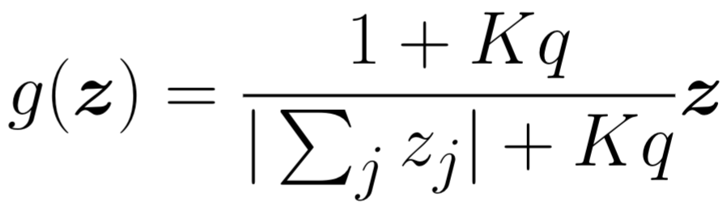
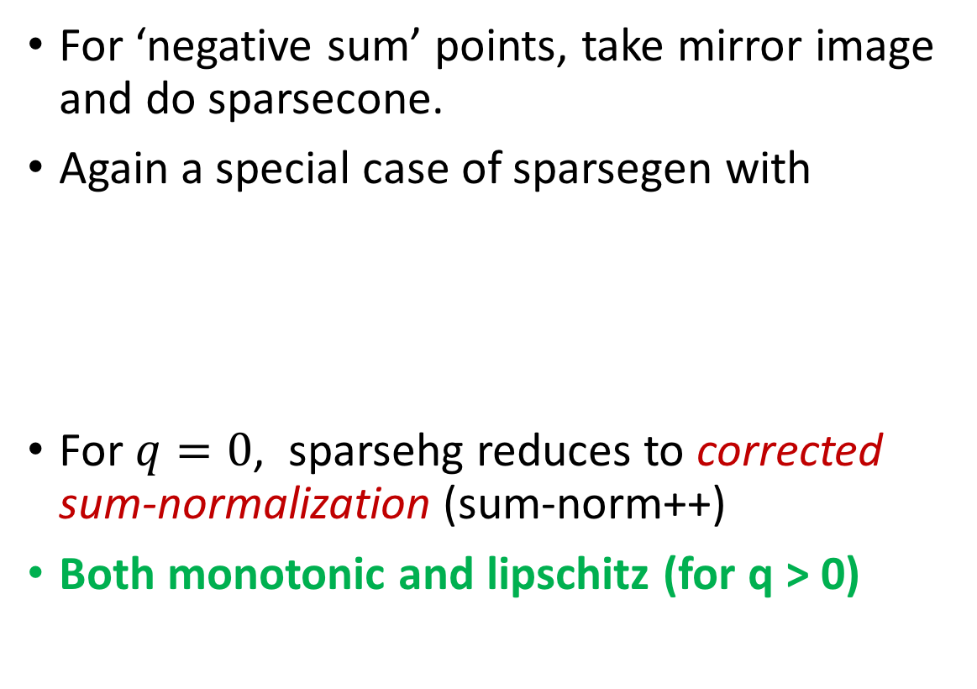
Sparse-hourglass
For ‘negative sum’ points, take mirror image and do sparsecone.
Again a special case of sparsegen with
For $q=0$, sparsehg reduces to corrected sum-normalization (sum-norm++)
Both monotonic and lipschitz (for q > 0)
Notes:
When \sum_i zi < 0 we take a mirror point of z. In figure z -> \tilde{z}.
When q = 0 we get sum-norm++ which is defined for negative values also. It is also monotonic.

Slide 39
Sparse maps results in non-convex loss
If sparse output layer is there in a model then with any loss function the model objective function won’t be convex.
label
Model
probability
map func
Loss function
input
Loss = C
Loss = 0
Loss = C
Loss = 0
Sparsemax
z₁
Notes:
Any model which has a sparse output layer before loss function will result in non-convex objective function.
In the diagram in bottom left (contour plot) we assume a case where correct label is z_2. For all the z values in green region loss should be 0 as predicted probability is [0,1]. For the red region predicted probability is [1, 0]. [1,0] will incur a loss as correct output should have been [0,1]. For all the values in red region loss will also be same as predicted prob is same. This function is clearly non-convex. Diagram in bottom right is a cross section of the contour plot which makes it easier to see why this function is non-convex. Using the property that for any convex function line connecting any to points in a function should be above the function, which is being violated here.

Slide 40
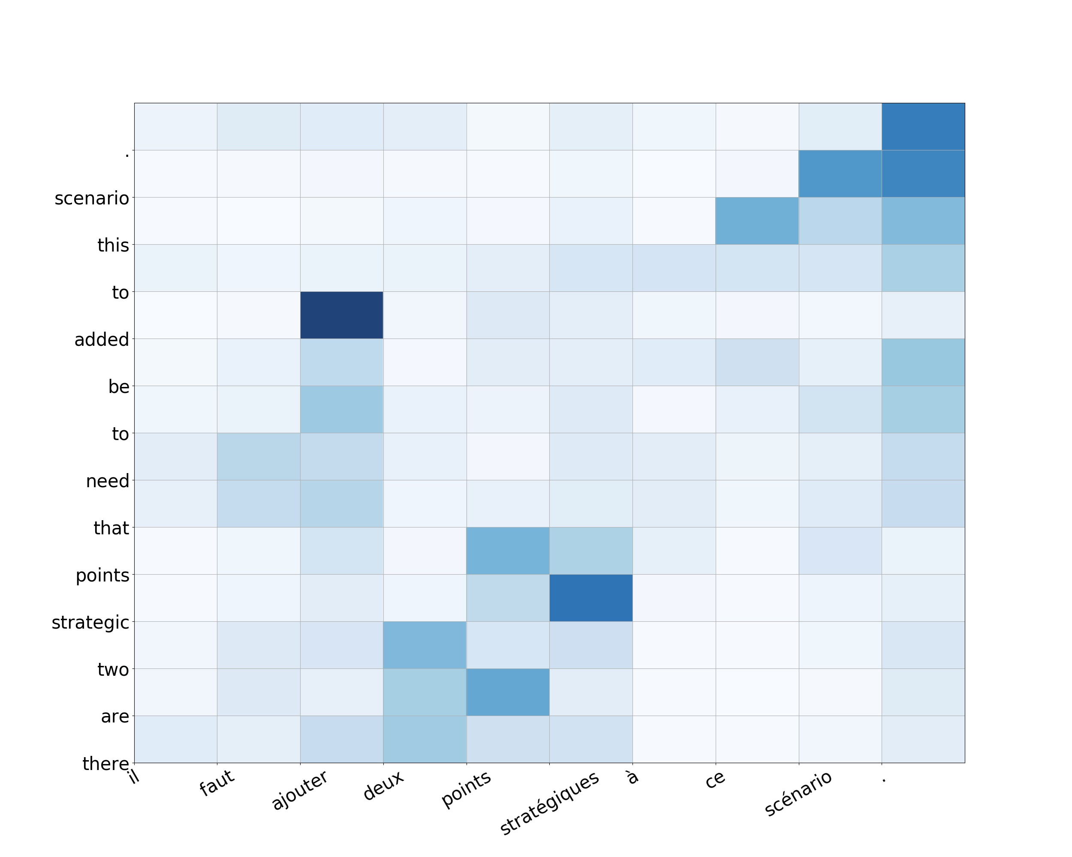
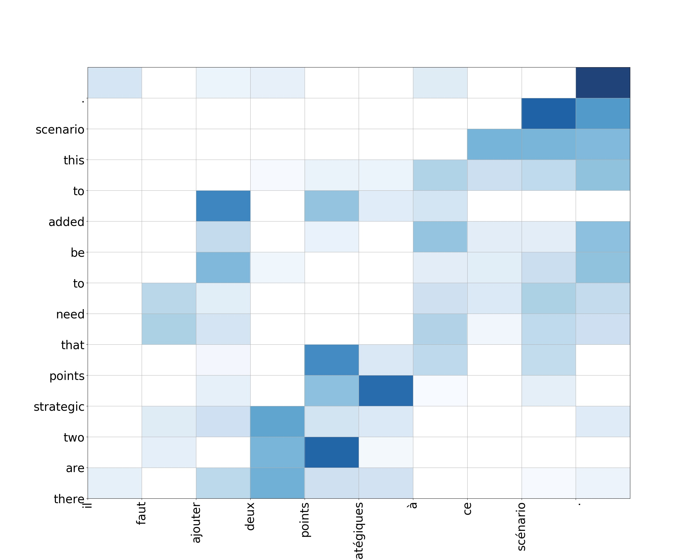
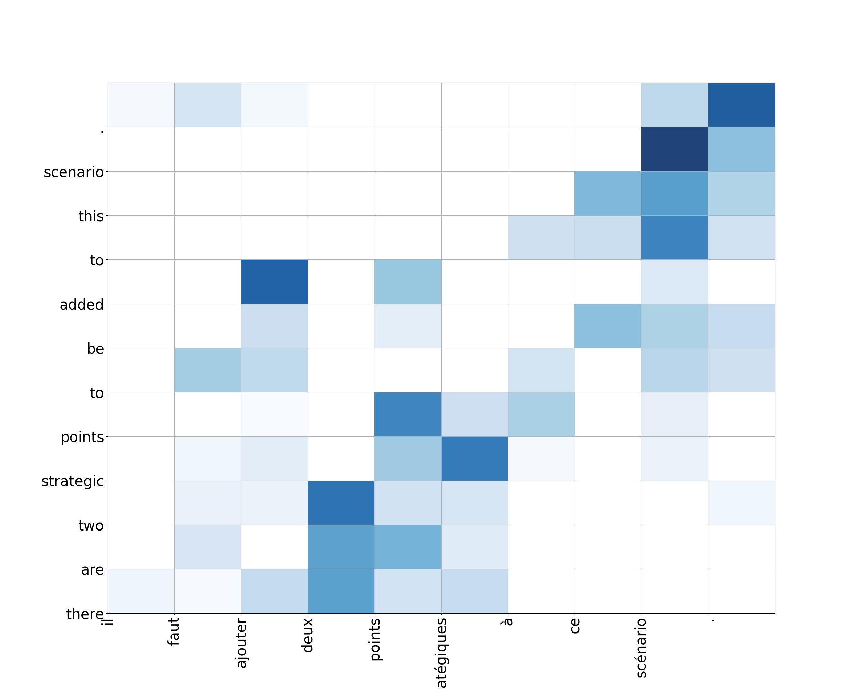
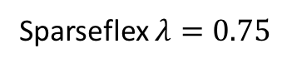
Sparse Attention for Natural Language Generation
Attention weights on words
softmax
sparsemax
Sparseflex $λ=0.75$
Notes:
These are results for abstractive sentence summarization.

